Slide 1
Python Workshop #1
Jonathan Chen
2025 SS

Slide 2
Purpose
Discover a (powerful) tool.

Slide 3

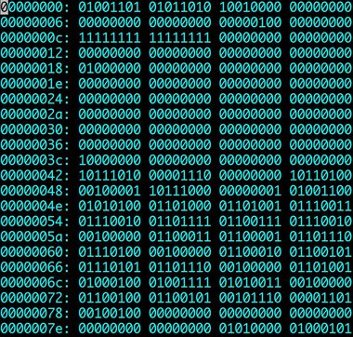
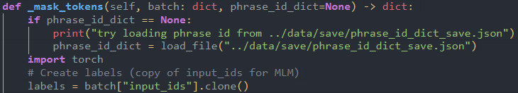
Machine Code
Script/Program
Interpreter

Slide 4
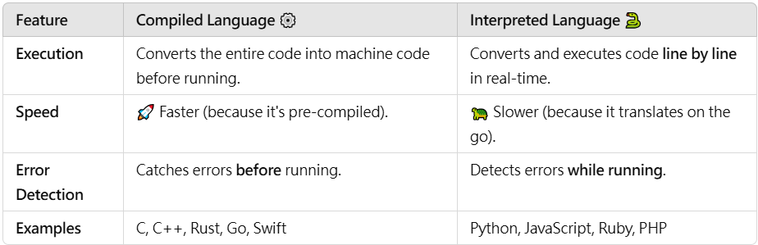
Interpreter

Slide 5
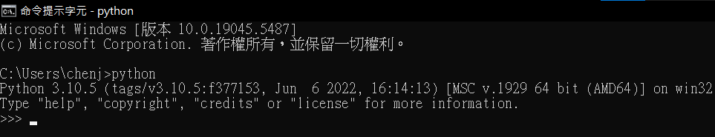
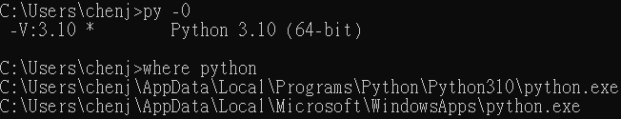
Talk to PC windows: CMD / macOS: Terminal
Check Pythons macOS: which –a python

Slide 6
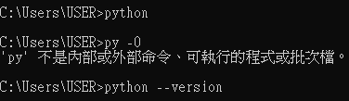
Talk to PC windows: CMD / macOS: Terminal
No Python macOS: which –a python

Slide 7
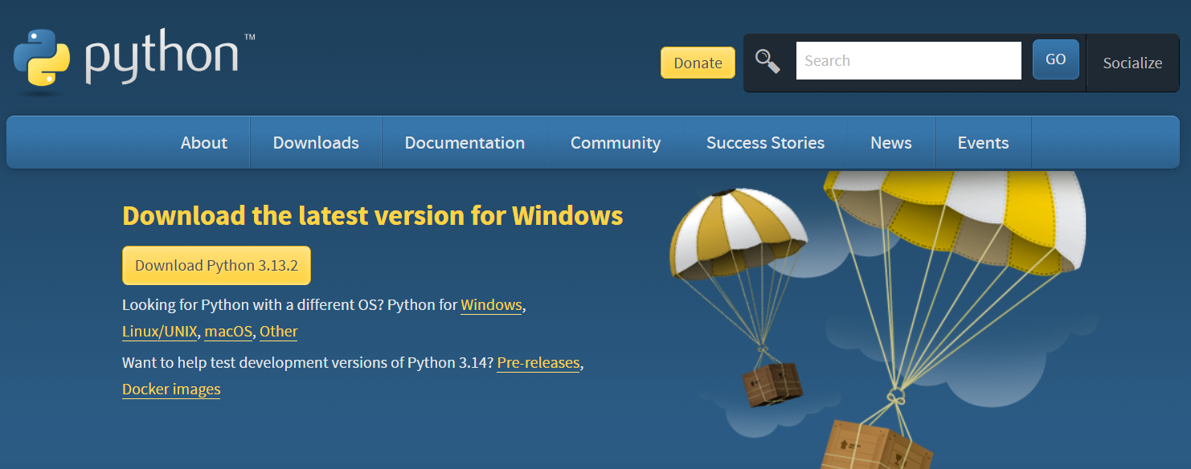
Python Interpreter
https://www.python.org/downloads/

Slide 8
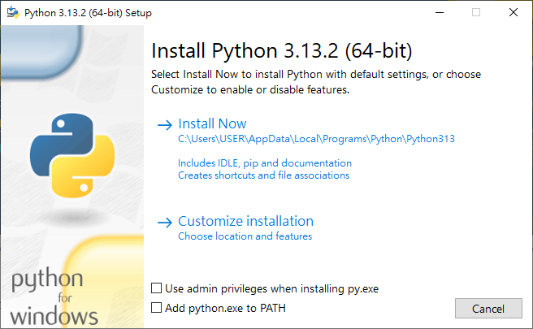
Python Interpreter
V
https://www.python.org/downloads/

Slide 9
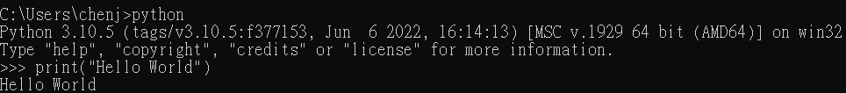

Talk to Python windows: CMD / macOS: Terminal
Editor
write & edit Python code

Slide 10
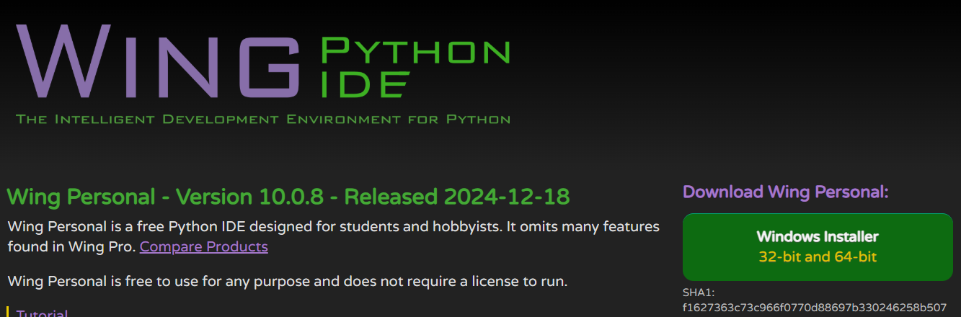
Python IDE
https://wingware.com/downloads/wingide-personal

Slide 11
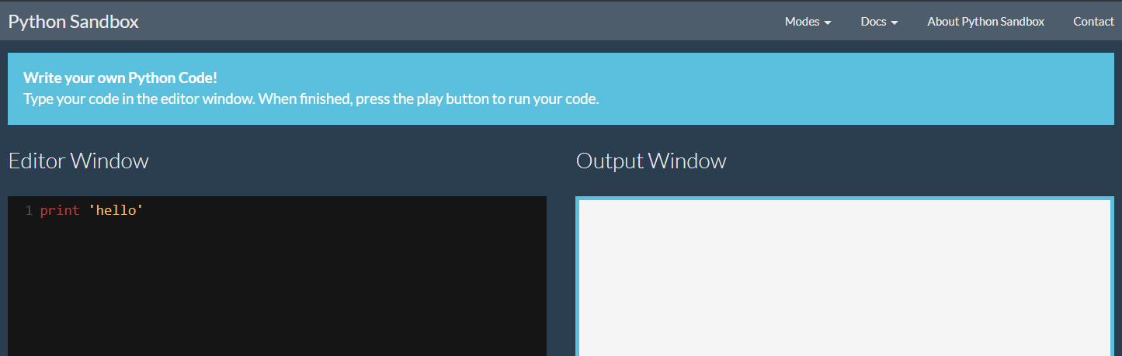

Python Sandbox if you cannot install an IDE
https://pythonsandbox.com/

Slide 12

Machine Code
Script/Program
Interpreter

Slide 13
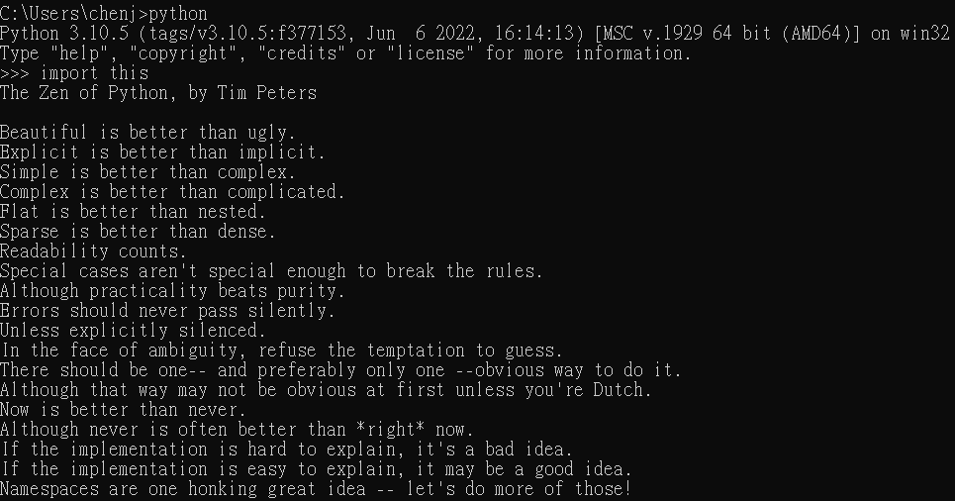
Run!

